Slide 1





Movie Recommendation System
CPIT 440
Team Members:
Muath Abbas Eissa [2338818]
Meshal Ahmad AlAjliani [2335521]
Hashim Yaser Bajaber [2336321]
Mohammed Khalid Alahmadi [2340345]
Submitted to: Dr. Mahmoud
December 6, 2025

Slide 2







Project Overview & Goals
Overview
Goals
Movie Recommendation System
Expected Outcomes
Development of a system that identifies meaningful patterns in movie data
Predict what movies a user may enjoy based on similarities
Groups similar movies together using clustering techniques
Identify movies with similar genres and numerical characteristics
Applies K-Means clustering algorithm to analyze movie attributes
Generate meaningful movie recommendations to users
Create a model that forms groups of similar movies

Slide 3












Dataset Information
Source & Size
Key Features
IMDB Dataset
Main Genre
Side Genre
IMDB_All_Genres_etf_clean1.csv
Primary genre classification of movies
Secondary genre classification
Rows (Movies)
5,562
Columns (Attributes)
Rating
Runtime (Mins)
10
Movie rating information
Duration of movies in minutes

Slide 4





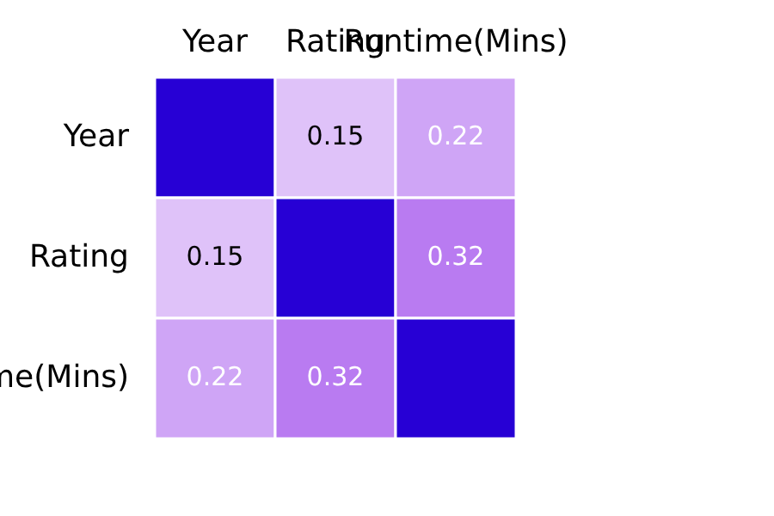
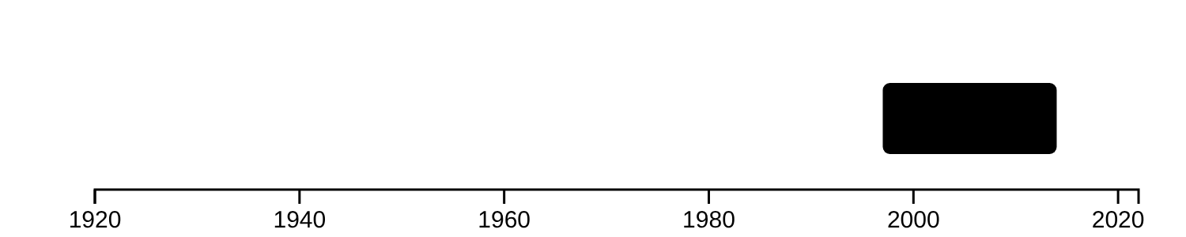




Data Exploration Results
Release Year Analysis
Correlation Study
Range: 1920 - 2022
A correlation matrix was generated to understand the relationships between numerical attributes.
Median: 2007
Q1: 1997
Q3: 2014
IQR: 17 years
Rating Distribution
The dataset includes movies with various rating distributions.
Key Finding
A histogram would show the frequency of movies across different rating ranges.
Strongest correlation (excluding self-correlation): Rating ↔ Runtime(Mins): 0.323

Slide 5
















Methodology & Approach
Task Formalization
This project is formalized as a clustering task, utilizing the K-Means algorithm to group movies based on similarities in their content-based attributes and numerical features.
Data Preprocessing Pipeline
Combining Text Features
Text to Numerical Conversion
Numerical Attribute Inclusion
Feature Scaling
MinMaxScaler
Movie Title
CountVectorizer
Rating
Ensures appropriate contribution
Main Genre
Converts text to numerical form
Runtime
Side Genre
Enables K-Means processing
Year
To clustering process

Slide 6










Feature Selection Strategy
For the clustering model, we selected specific attributes that meaningfully describe movie content and measurable characteristics:
Main Genre
Side Genre
Primary genre category that defines the movie's core classification and theme.
Secondary genre information that provides additional context and nuance to the movie's classification.
Rating
Runtime (Mins)
User rating that reflects audience reception and provides a measure of movie quality and popularity.
Duration of the movie providing information about viewing time commitment and pacing.

Slide 7









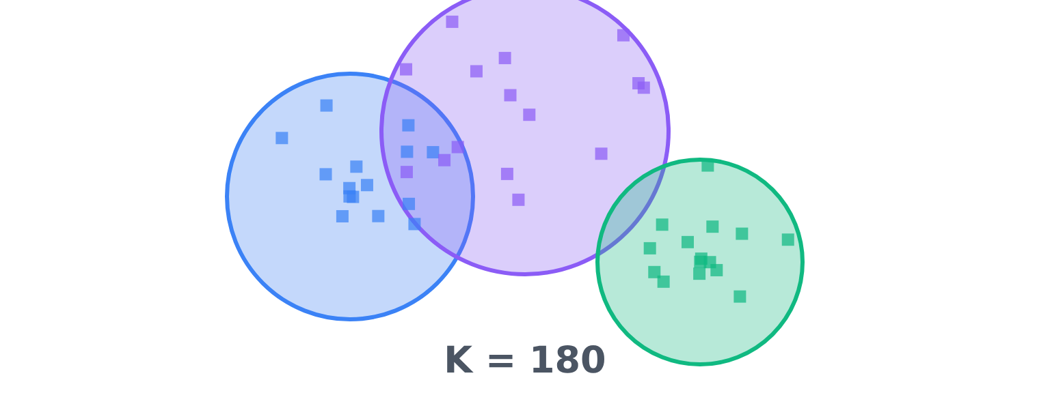



Model Training Process
K-Means Algorithm
Cluster Selection
Implementation
Elbow Method
Applied K-Means clustering to movie data attributes
Elbow Method did not show a clear or strong elbow point
Used numerical representation of genres with rating and runtime
Tested various K values to assess cluster quality
Selected K = 180
Produced movie clusters with better genre-based similarities
Created more meaningful groups of similar movies

Slide 8



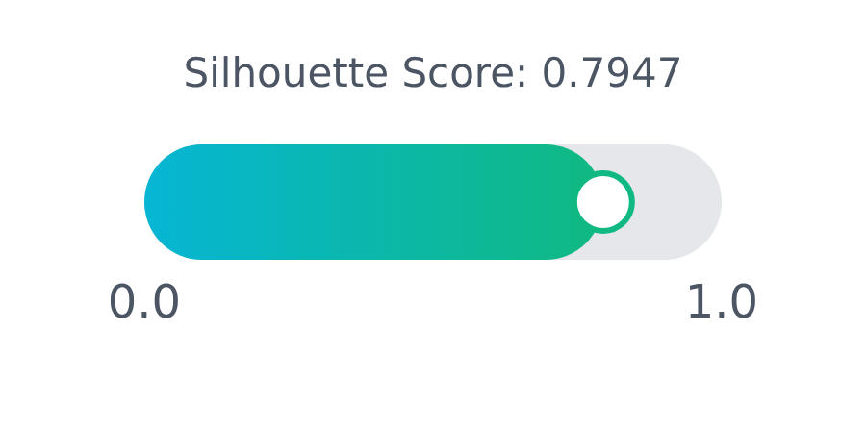




Evaluation & Performance
Performance Metrics
Results & Validation
Within-Cluster Sum of Squares
Silhouette Score Visualization
Evaluates cluster compactness across different values of K
Silhouette Score
Measures how similar an object is to its own cluster compared to other clusters
0.7947
Key Findings
High Silhouette Score indicates effective cluster separation
Movies within clusters are highly similar
Manual inspection confirmed thematic similarities between clusters

Slide 9
















Implementation Challenges
Inconsistent Genre Information
Balancing Feature Influence
Preparing the data required careful handling of inconsistent genre labels.
Determining how to balance the influence of different features.
Movies had multiple genre tags that needed merging
Adjusting numerical values like ratings and runtime
Standardizing genre descriptions for consistency
Ensuring no single feature dominated the clustering
Optimal Cluster Selection
Manual Cluster Validation
Choosing the appropriate number of clusters was difficult.
Evaluating the meaningfulness of the resulting clusters.
WCSS values did not form a clear "elbow" point
Manual inspection of movie groups required
Relying on Silhouette analysis for cluster quality
Confirming thematic and structural similarities

Slide 10







Conclusion & Results
Project Summary
The project successfully applied K-Means clustering to group movies based on their main and side genres, along with numerical features like rating and runtime. This clustering approach created meaningful similarity patterns between films, establishing a strong foundation for a content-based movie recommendation system.
Meaningful Grouping
Content-Based Foundation
Performance Metrics
K-Means clustering successfully identified groups of movies with similar genres and characteristics, creating logical groupings that align with user preferences.
The final model with K=180 achieved a Silhouette Score of 0.7947, indicating well-separated clusters with high intra-cluster similarity.
The clustering step provides a solid foundation for developing a content-based recommendation system where similar films can be suggested to users.
Key Achievement: Manual inspection confirmed that movies within the same cluster consistently shared similar genres and themes, validating the effectiveness of the clustering setup for generating meaningful recommendations.

Slide 11











Future Work & Improvements
User Feedback Evaluation
Alternative Clustering
Implement systems to evaluate recommendations using real user feedback or viewing history to measure effectiveness.
Test different clustering techniques like hierarchical clustering or DBSCAN to explore potentially better movie groupings.
Data-driven improvements
Improve clustering accuracy
Automated Feature Learning
Automate the process of determining which movie features are most important for recommendations, rather than manual selection.
Reduce manual intervention

